Slide 1
Implementation of K Nearest Neighbors in Java
By Anthony Schroeder and tanner stoops

Slide 2


What is K Nearest Neighbors
K Nearest Neighbors is a non-parametric, instanced-based learning algorithm
Non-parametric meaning that instead of using a probability distribution derived from the data. It is compared directly against the training data
Instance-based learning, lazy learning, instead of creating an abstraction from the training data, it instead stores all the training data and compares the query to the data and classifies it according to its nearest neighbors

Slide 3
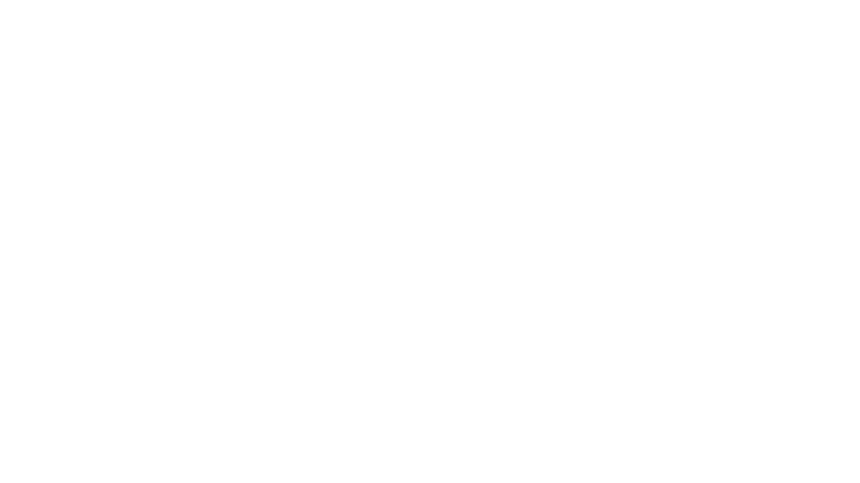
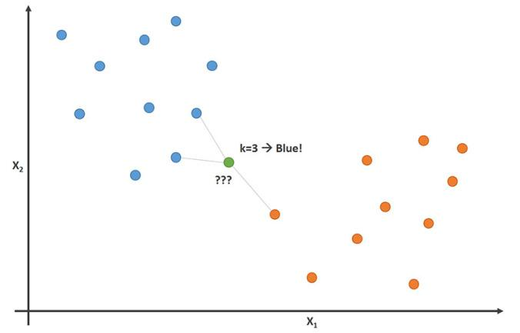
What is K Nearest Neighbors
K Nearest Neighbors is a simple algorithm where the test data is compared to all training data points by using one of the methods to find distance between it and the rest of the data, takes the K nearest data points and then classifies the test data according to whatever the majority that its nearest neighbors are.

Slide 4

Which Formula
A study on KNN showed that the depending on the data, different equations performed better
Two of the most common equations:
The most used formula is the normalized Euclidean function $dist\left(A,B\right)=\sqrt{\frac{\sum_{i=1}^{m}{(x_{i}−y_{i}})^{2}}{m}}$
Cosine Similarity Measure is used to measure the cosine angle between two vectors cos$θ=\frac{A∗B}{\left|A\right||B|}$

Slide 5
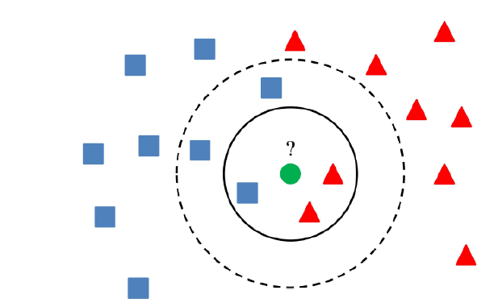
How to Choose K
There is no set way to find K so we will first set K to the square root of n, where n is the number of training data entries:
Large values for K can take a long time computationally, and if it is too large then everything is the most probable class
Small values for K, noisy values can have a large effect

Slide 6
Pros/Cons of K Nearest Neighbors
Pros
No assumptions are made about the data
Simple, its is easy to explain and understand
High Accuracy-it excels in classification
Classifier can updated easily as new instances with known classes are added
Cons
Since each testing data point is compared to all the training data points it can be computationally expensive
It can sensitive to noisy data, outliers
Sensitive to very unbalanced datasets

Slide 7
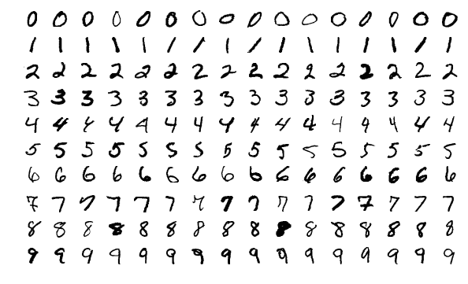
The Data Set
We are using MNIST data of handwritten digits, it contain a data set of 70,000 handwritten digits from 0-9. 60,000 of these used for training purposes while the remaining 10,000 are used to test the algorithm's accuracy.

Slide 8
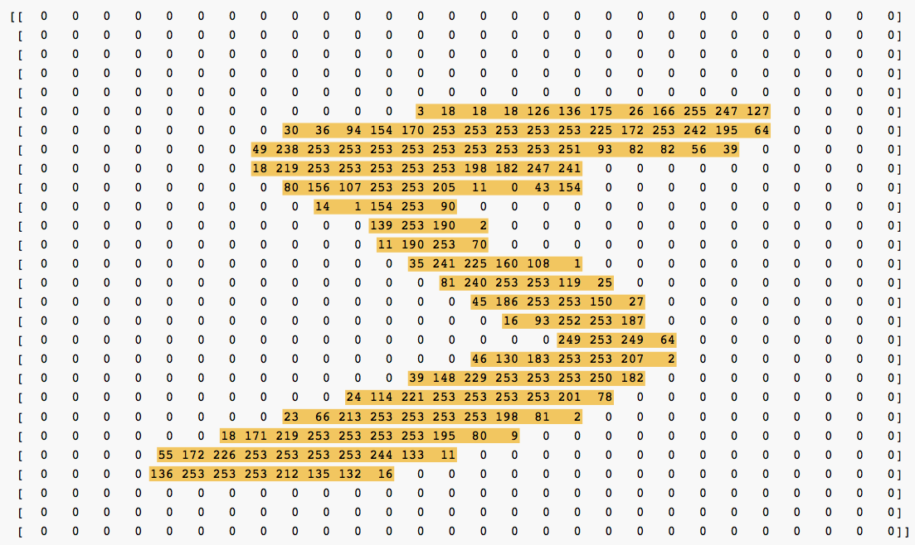
Mnist
Each of these images in the dataset are 28 by 28 and are gray scale. This means that each image can be thought of as a 28 by 28 matrix with each cell representing a pixel, the pixels’ values range from 0-255, with 0 being white and 255 being black. The benefit of the data being in gray scale is that only one matrix needs to be used. We treat the matrix as one long vector with 784 dimensions.

Slide 9
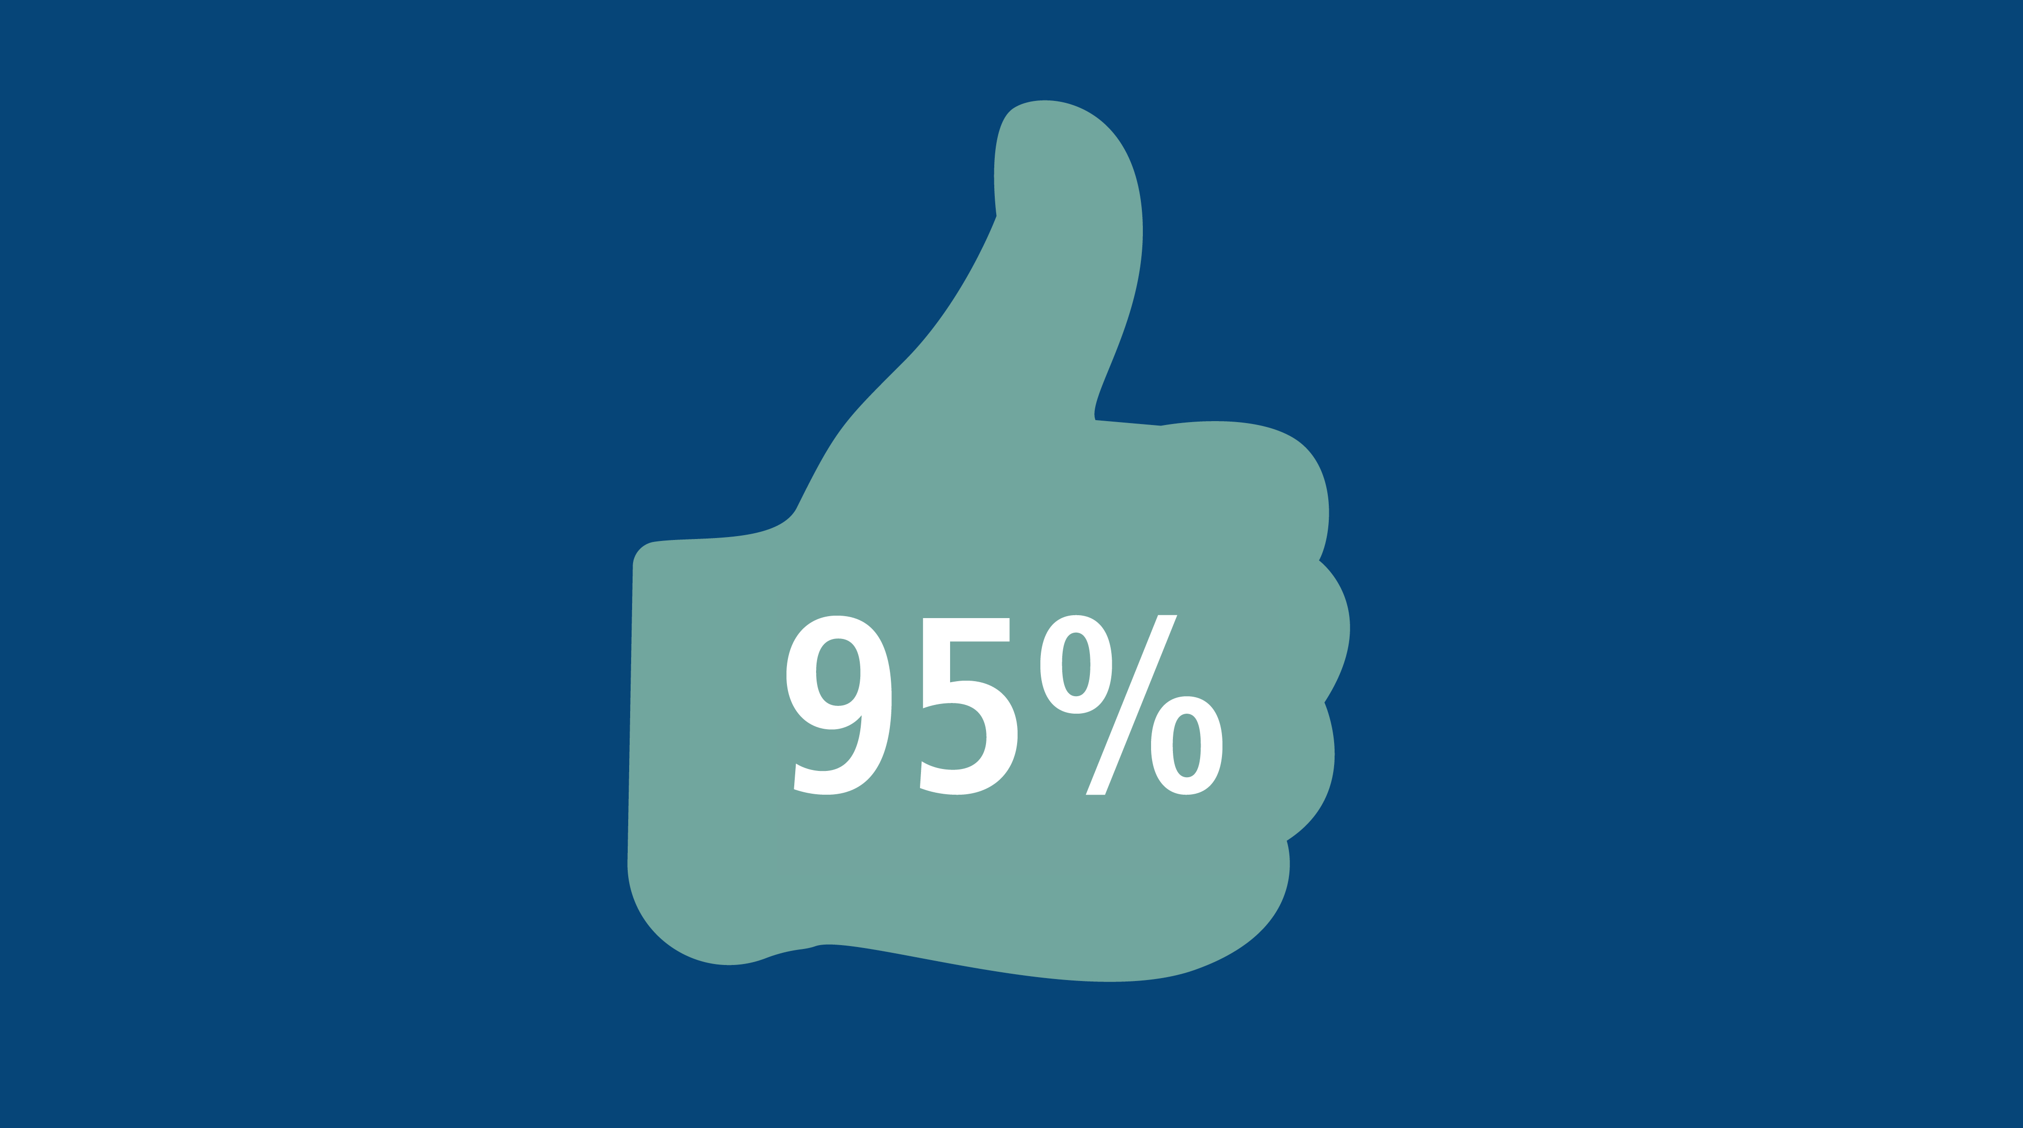
Success
The highest performance of KNN is around 97%. Our goal is to get 95% percent or higher on the MNIST test set. We believe we can achieve our goals with the proper distance formula and k selection.

Slide 10
In the Future
A major reason that KNN is not used more often is because of how computationally expensive it can be. Each data entry that you want to find the label of has to be compared with every other data entry. With the MNIST, that means a K of just 1 means that about 60,000 comparisons need to be done. Obviously, this can take a long time so a good idea would be to parallelize the comparisons, so instead of 1 comparison at a time we can do several drastically reducing the time.

